Slide 1
PANIMALAR ENGINEERING COLLEGE
B.E. COMPUTER SCIENCE AND ENGINEERING
21CS1512 – SOCIALLY RELEVANT MINI PROJECT
DOMAIN: Mobile Application Development.
TITLE: SENTRIX : Enhancing Public Safety Through Crime Analytics.
By:
Sarupriya P [Reg No:211422104441]
Revathi K [Reg No:211422104394]
CSE III – C
Mentor: Dr. M.S.Vinmathi

Slide 2
C
ABSTRACT :
Sentrix is an Android app designed to enhance public safety and crime awareness. It enables real-time crime reporting, live location sharing, and notification triggering. Using K-Means clustering and predictive analytics, the app maps crime-prone areas and provides geo-fencing for added safety. Sentrix supports multiple languages (English and Tamil) and simplifies FIR filing with proof uploads and automatic location/time filling. The app features distinct interfaces for citizens and police, enables efficient coordination and faster response times.

Slide 3
Existing System:
Existing systems rely on static crime data and basic reporting methods, with limited real-time features and interaction between police and citizens. These systems typically have heavier applications, lack dynamic updates, and offer minimal community engagement and real-time tracking capabilities. They often involve manual data processing, which can lead to errors and delays in response, and do not effectively utilize advanced technologies for crime prediction and prevention.

Slide 4
Proposed System:
● Real-Time Crime Alerts: Users will receive instant notifications about ongoing crimes or suspicious activities in their area.
● Streamlined Reporting Process: The app will allow quick crime reporting with auto-filled location details and the ability to attach proof, improving report accuracy and speed.
● Predictive Analytics: AI and machine learning will analyze historical crime data to identify and predict crime-prone areas, helping users avoid risks.
● Enhanced Communication: A direct communication channel between citizens and law enforcement will allow users to track report statuses and receive updates.
● Geo-Fencing: Users will receive alerts when entering or exiting specific crime-prone areas for proactive safety.
● Community Engagement: The app will encourage user feedback and participation in safety initiatives to foster community involvement.

Slide 5
DEVELOPMENT ENVIROMENT
SOFTWARE REQUIREMENT
● Android Operating System Version 7.0 OR Higher
● Java Development Kit (JDK) Version 8 OR Higher
● Android Studio IDE Version 4.0 OR Higher
● Programming Languages: Java, XML
● Machine Learning Libraries: k means,scikit-learn
● Firebase: Real-time database and authentication services
● Google Maps API: For geolocation and mapping features
HARDWARE REQUIREMENT
● Android device with a minimum of 2GB RAM and 16GB internal storage.
● Mobile with Camera and GPS tracker

Slide 6
MODULE DESCRIPTION:
1.Crime Mapping and Analytics Module:
Sentrix uses K-Means clustering and predictive analytics to map crime-prone areas, identify hotspots, and assist law enforcement, while helping citizens stay aware of high-risk zones.
2. Crime Reporting Module :
Sentrix allows users to report crimes in real time with a user-friendly interface that auto-fills location and time using GPS. Users can upload images and videos as evidence, and trigger an emergency alarm to alert nearby users and authorities instantly.
3. Geofencing Module :
Sentrix implements geo-fencing to define crime-prone areas, sending voice alerts when users enter or exit these zones. It enhances safety with real-time visual and audio notifications of nearby threats.

Slide 7
4. Crime Meter and Reports :
The Crime Meter provides real-time crime updates with a pie chart for quick analysis, while the Crime Report section offers detailed reports with auto-filled data. Police can instantly access uploaded evidence for faster investigation and response.
5. Prioritize Department :
Sentrix optimizes resource management by using real-time data to identify high-priority areas, enabling effective allocation of personnel and equipment. It enhances strategic planning with data-driven insights, improving public safety and community trust.
6. Shortest Path Navigation :
Sentrix provides optimized real-time routing for law enforcement using GPS to calculate the fastest routes based on traffic conditions and road closures, with options for route customization to avoid high-traffic areas.

Slide 8
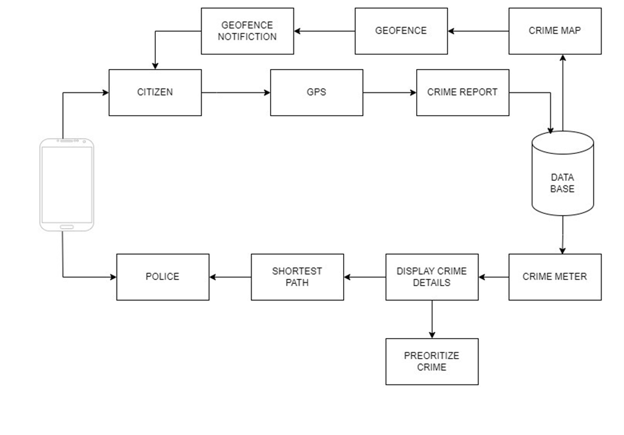
ARCHITECTURE DIAGRAM

Slide 9
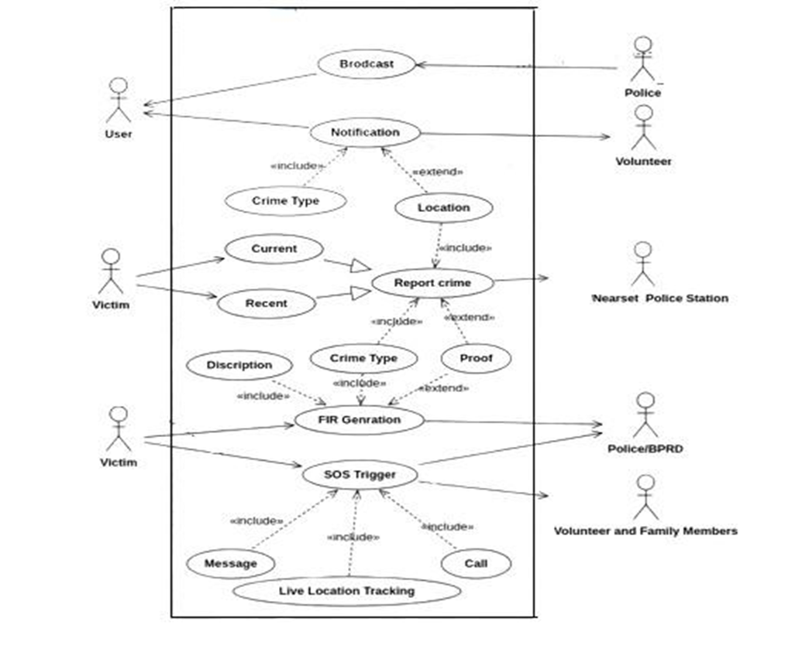
USE CASE DIAGRAM:

Slide 10
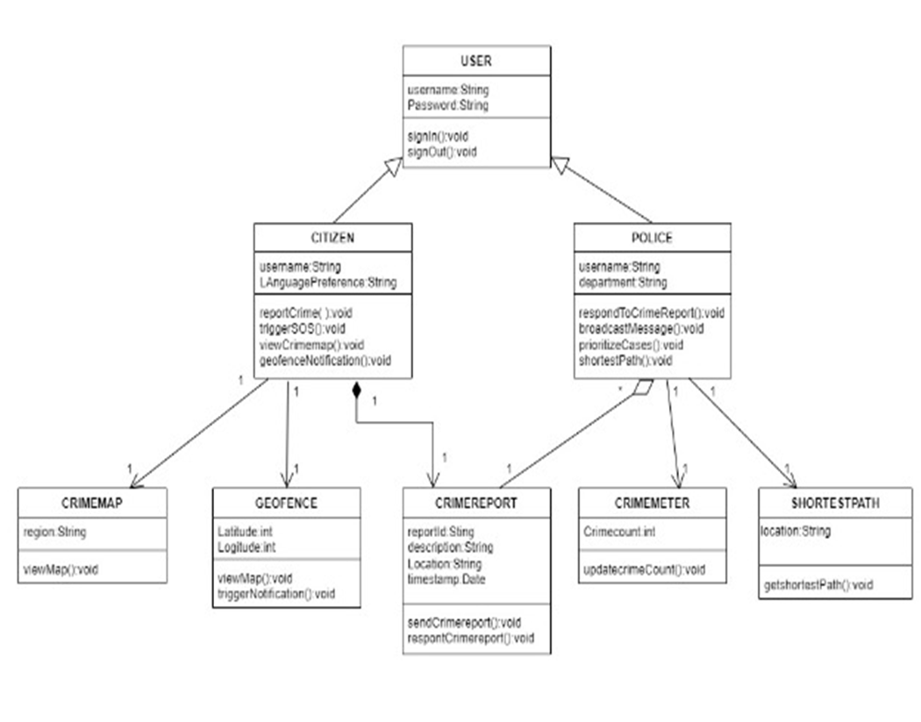
CLASS DIAGRAM

Slide 11
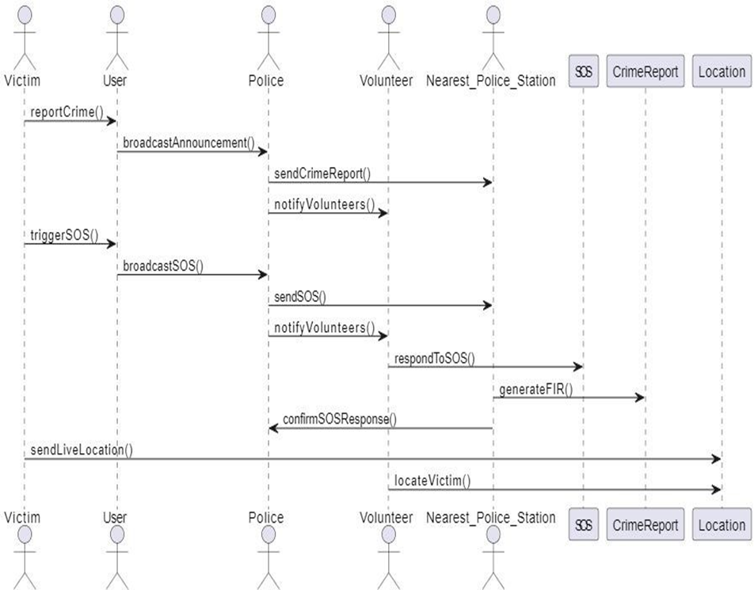
SEQUENCE DIAGRAM :

Slide 12
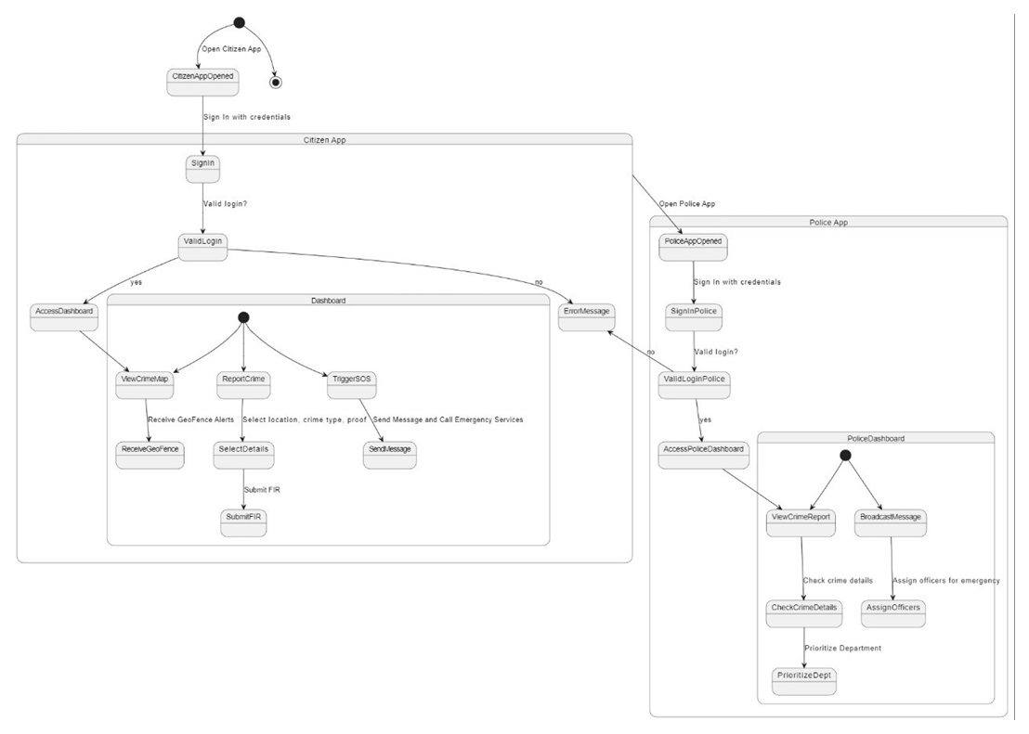
STATECHART DIAGRAM :

Slide 13
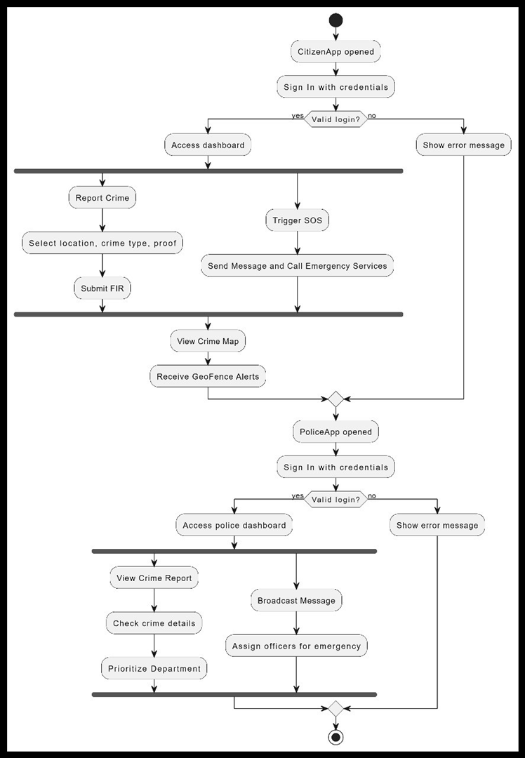
ACTIVITY DIAGRAM :

Slide 14
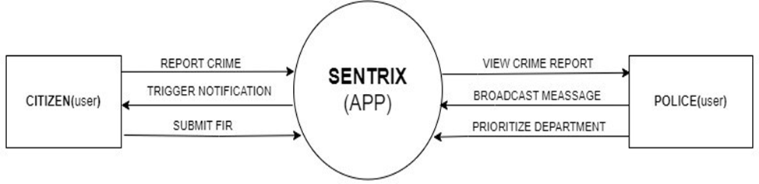
DATA FLOW DIAGRAMS
DATA FLOW DIAGRAM LEVEL 0

Slide 15
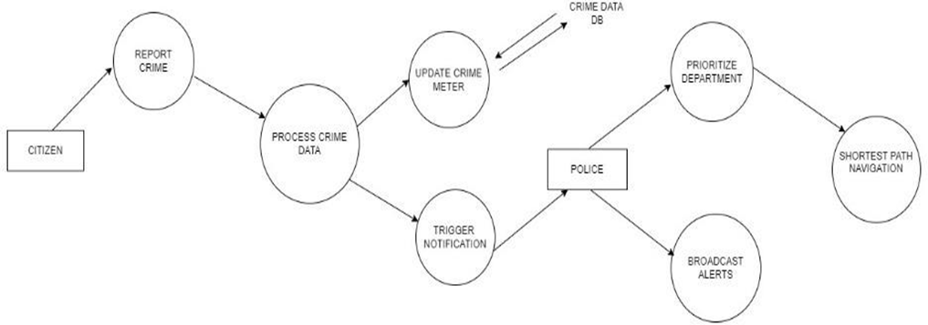
DATA FLOW DIAGRAM LEVEL 1

Slide 16
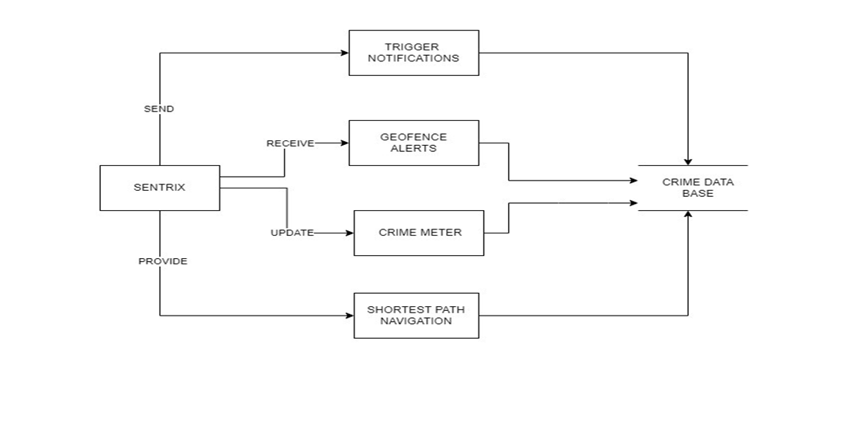
DATA FLOW DIAGRAM LEVEL 2

Slide 17
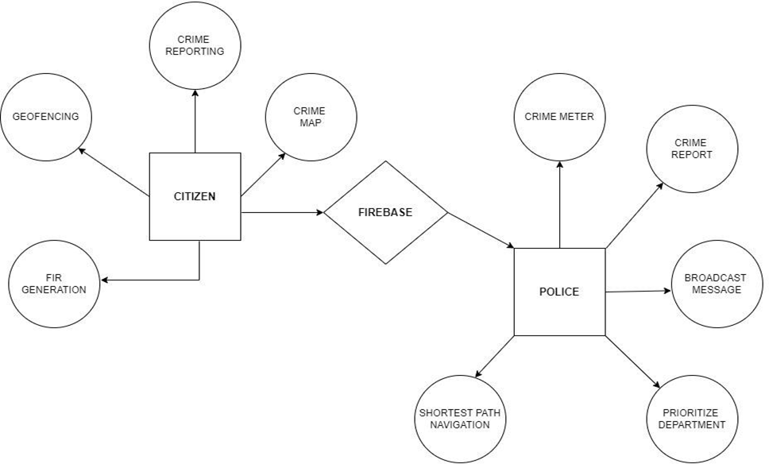
ENTITY RELATIONSHIP DIAGRAM :

Slide 18
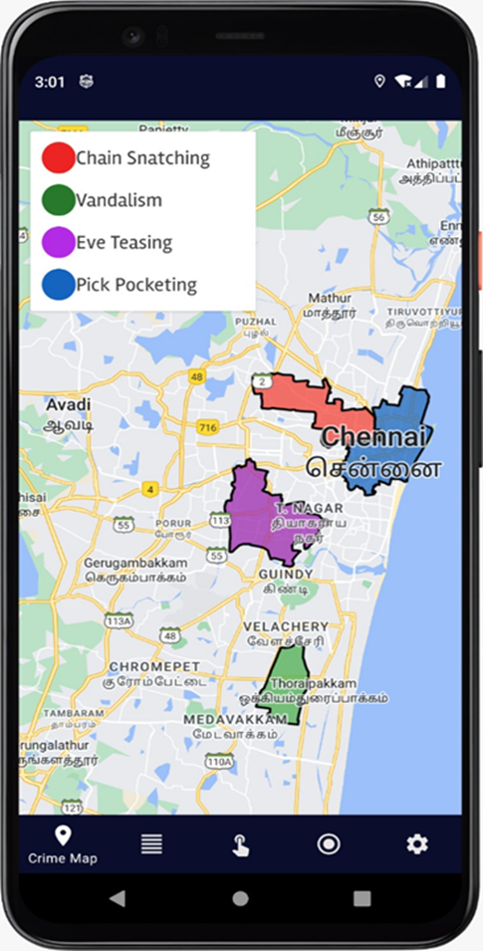
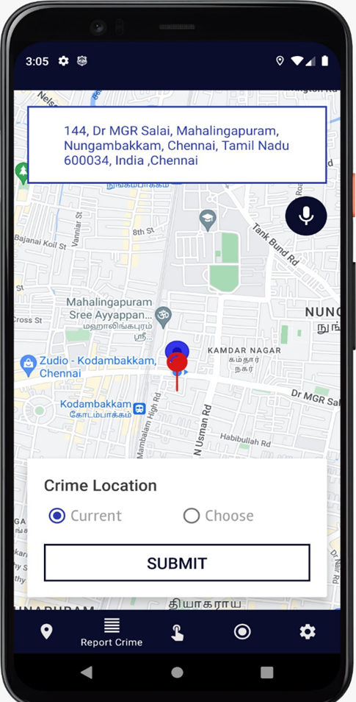
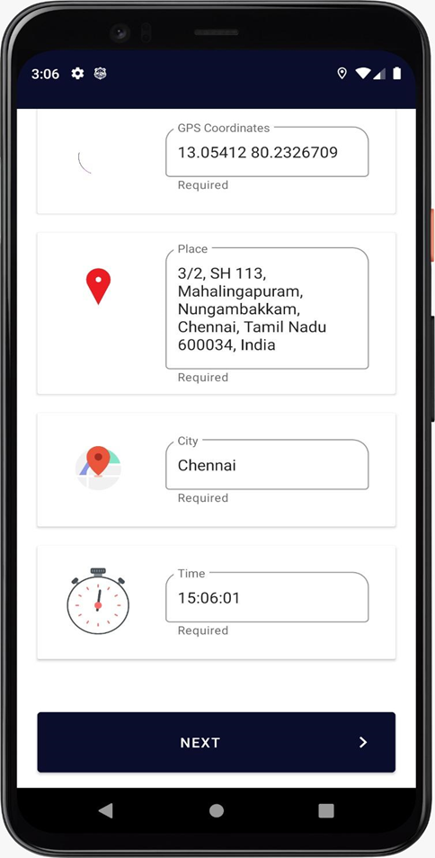
CRIME PRONE MAP REPORT CRIME REPORTER DETAILS

Slide 19
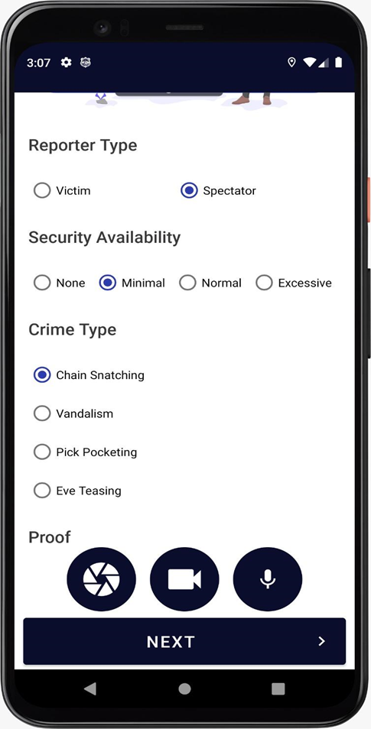
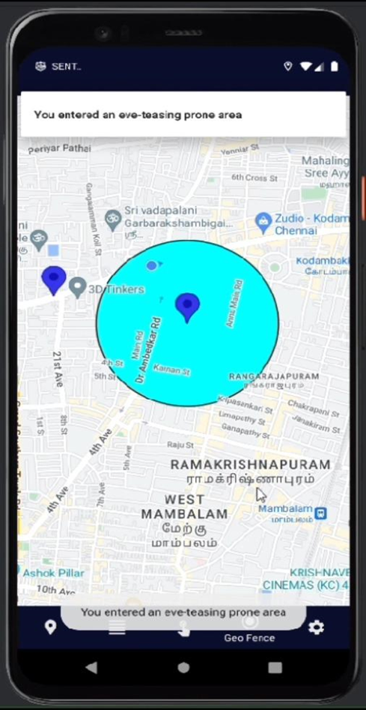
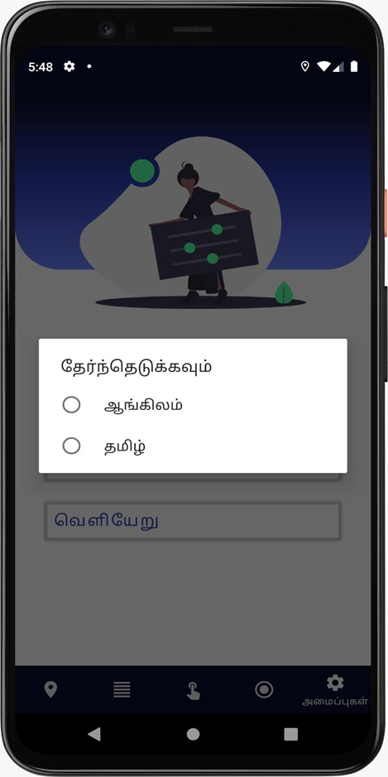
CRIME DETAILS GEOFENCING APP LOCALIZATION

Slide 20
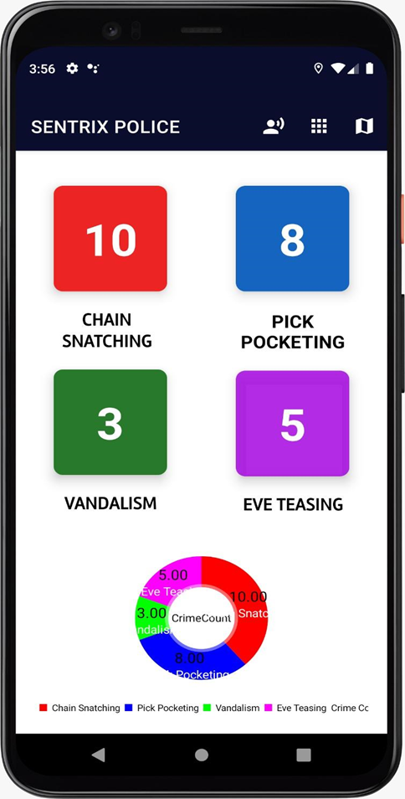
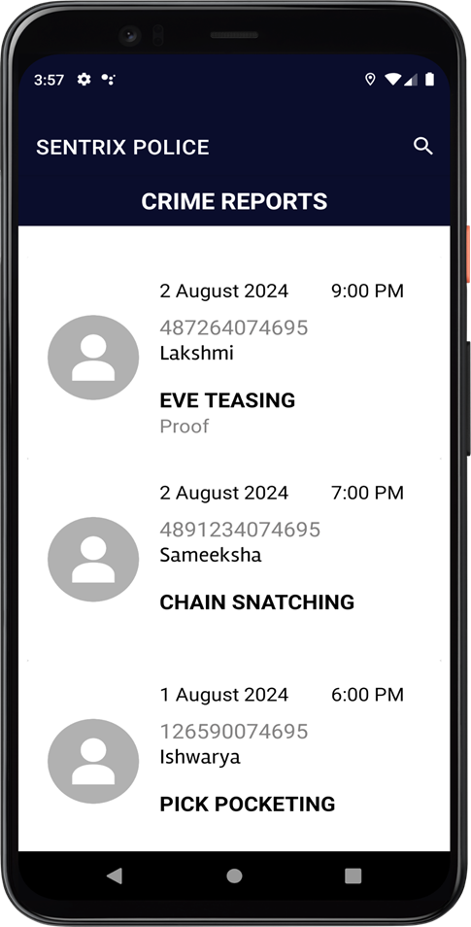
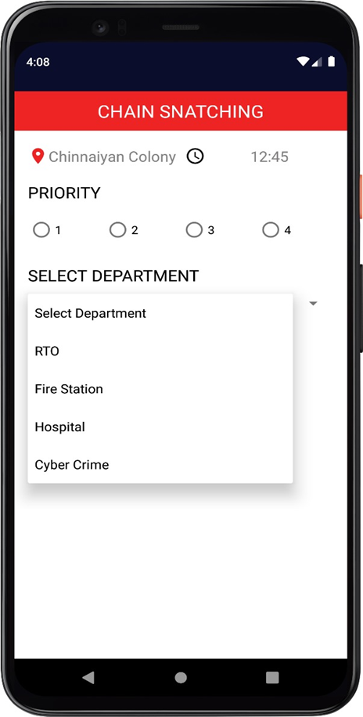
CRIME METER CRIME REPORT PRIORITIZING

Slide 21
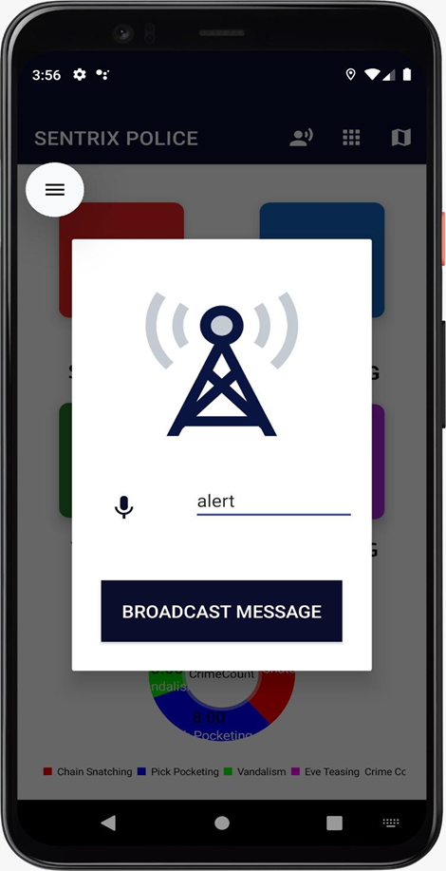
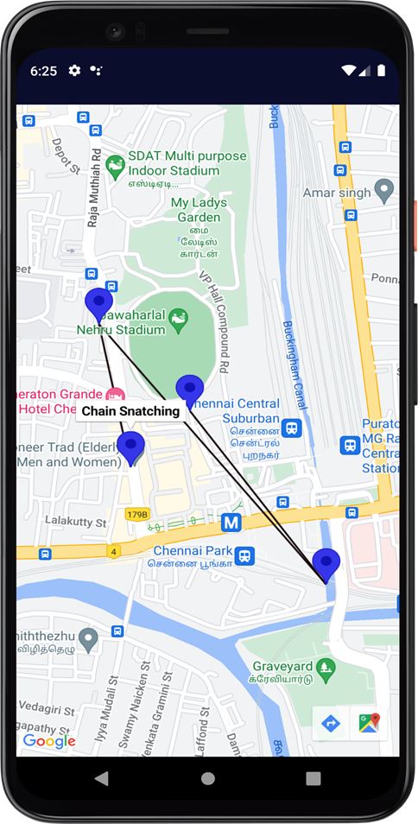
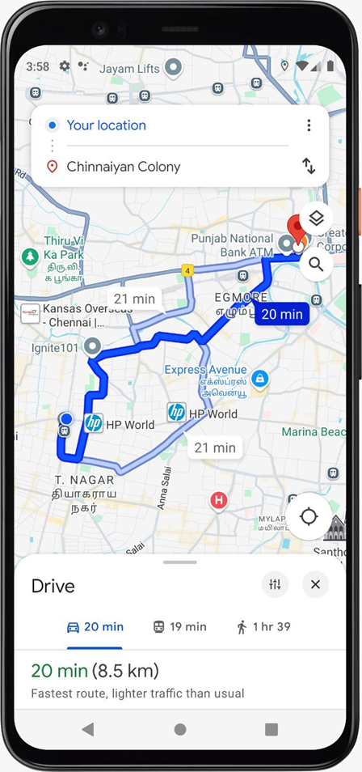
BROADCAST MESSAGE CRIME REPORT MAP SHORTEST PATH

Slide 22
CONCLUSION :
Sentrix serves as a key technological solution to enhance public safety and crime awareness. By enabling seamless real-time crime reporting and monitoring, it strengthens the collaboration between citizens and law enforcement agencies. Key features like crime-prone region mapping, automatic crime reporting, and predictive analytics provide timely and effective responses to potential threats. With support for multiple languages, including English and Tamil, Sentrix ensures accessibility across diverse user groups. The app contributes significantly to improving security, reducing crime, and fostering stronger relationships between the public and law enforcement. Continuous improvements and feedback will be integral to its future development and effectiveness.
FUTURE ENHANCEMENTS :
1.Integrating the app with local emergency services such as fire departments, medical aid, and disaster response teams, providing users with a one-stop platform for reporting various emergencies and receiving immediate assistance
2. Implement AR-based features where users can view crime-prone areas or safety zones overlaid onto their camera feed, enhancing situational awareness when navigating unfamiliar areas.

Slide 23
REFERENCES :
[1] The Power of Predictive Analytics: Forecasting Crime Trends in High-Risk Areas for
Crime Prevention using Machine Learning DOI: 10.1109/ICCCNT56998.2023.10306731
[2] Visual Analysis of Predictive Policing to Improve Crime Investigation
DOI: 10.1109/IC3I46837.2019.9055515
[3] Crime Analysis and Prediction using Machine Learning Algorithms
DOI: 10.1109/ICCST55948.2022.10040319
[4] Crime Mapping in India: A GIS Implementation in Chennai City Policing
DOI: 10.1080/10824000409480651
[5] Geofencing 2.0: Taking Location-based Notifications to the Next Level
DOI: 10.1145/2632048.2636093
[6] High-performance FIR generation based on a timing-driven architecture component
Selection DOI: 10.1109/ISCAS.2002.1010568

Slide 24
THANK YOU

